Slide 1
Grand Challenges in BSDF Measurement and Modeling
Workshop on Light Redirection and Scatter:
Measurement, Modeling and Simulation 2014
Murat Kurt¹
¹International Computer Institute, Ege University
Notes:
In this presentation, we address the problem of finding a general solution for efficient BSDF measurement and representation. We also outline the main issues that do not allow the effective use of current BSDF representations. Finally, we suggest specific solutions that could be investigated in order to address these challenges.
.......
Measuring and representing reflection and transmission accurately are core to high fidelity visual simulation of materials. However,
state-of-the-art Bidirectional Scattering Distribution Function (BSDF) models do not suggest a general solution for any surface
class, from glasses to metals, isotropic to anisotropic materials, and daylight redirecting films. Furthermore, an accurate BSDF acquisition
is not a trivial task at especially some specific measurement angles, such as normal incidence and grazing angles. In this paper, we
address the problem of finding a general solution for efficient BSDF measurement and representation. We also outline the main issues
that do not allow the effective use of current BSDF representations. Finally, we suggest specific solutions that could be investigated in
order to address these challenges.

Slide 2
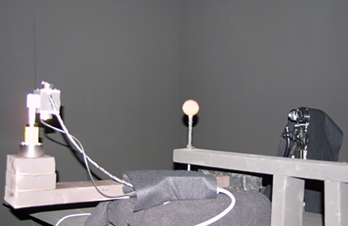
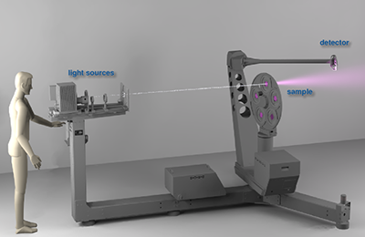
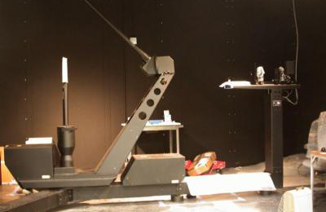
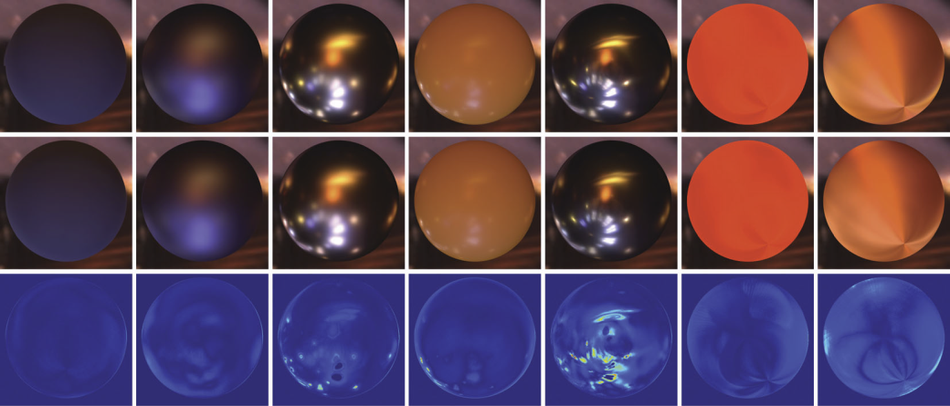
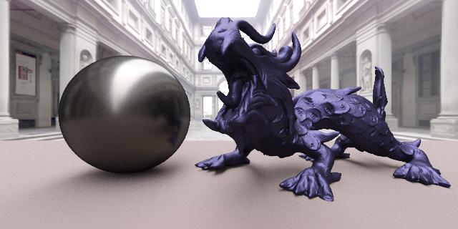
Introduction
Apian-Bennewitz [2014]
pgII Goniophotometer
Matusik et al. [2003]
BRDF Measurement Device
Bilgili et al. [2011]
A Factored BRDF Model
Pacanowski et al. [2012]
A BRDF Model Based on Rational Functions
Problem: Sparse, Irregular and Noisy Measurements
Notes:
Rendering complex scenes requires precise descriptions of materials involved. Some materials, such as papers, glasses, metals and daylight redirecting films, have a unique appearance. To measure these materials accurately, various measurement devices are used [Matusik et al. 2003; Ghosh et al. 2007; Apian-Bennewitz 2014]. After data measurement process, these measurements are represented by material models [Nicodemus et al. 1977; Walter et al. 2007]. Data-driven based material representations [Matusik et al. 2003;Pacanowski et al. 2012] are more successful to represent real-world materials. However, data-driven based representations pose some difficulties when measurements are sparse, irregular and noisy.

Slide 3
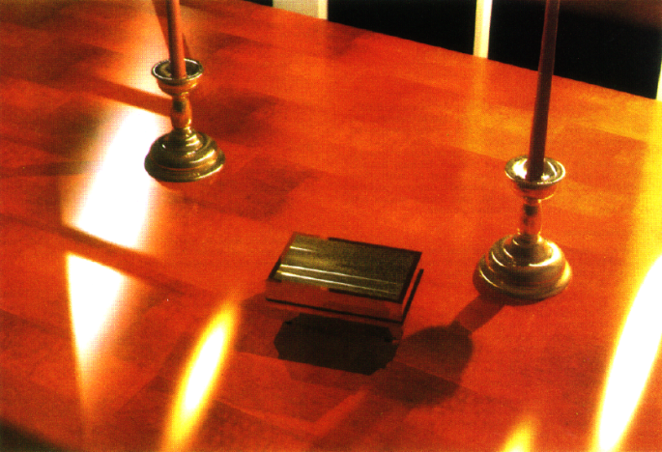
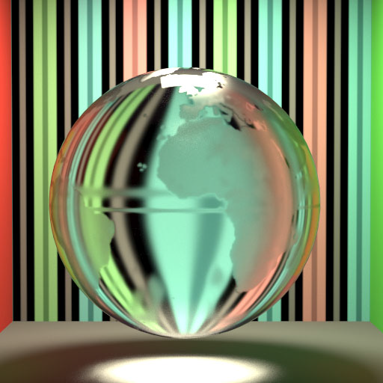
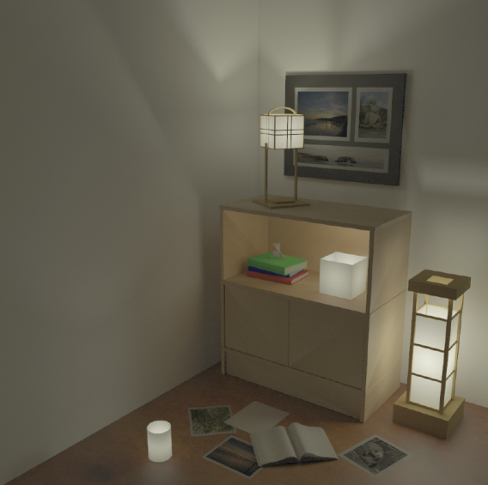
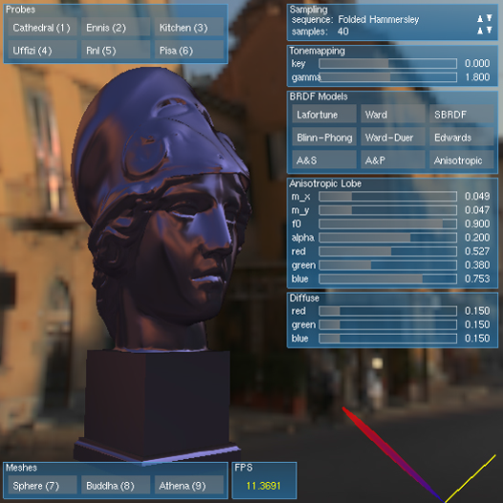
Introduction
Ward [1992]
An analytical BRDF model
Walter et al. [2007]
A Microfacet-Based BSDF Model
Papas et al. [2014]
A Physically-Based BSDF Model
Kurt et al. [2010]
An Anisotropic BRDF Model
Problem: Failing to Fit Some Material Types
Notes:
Analytical Bidirectional Reflectance Distribution Function (BRDF) representations, Bidirectional Transmittance Distribution Function (BTDF) representations and Bidirectional Scattering Distribution Function (BSDF) models try to model measurements with a few parameters. However, analytical models fail to fit some material types, such as daylight redirecting films.

Slide 4
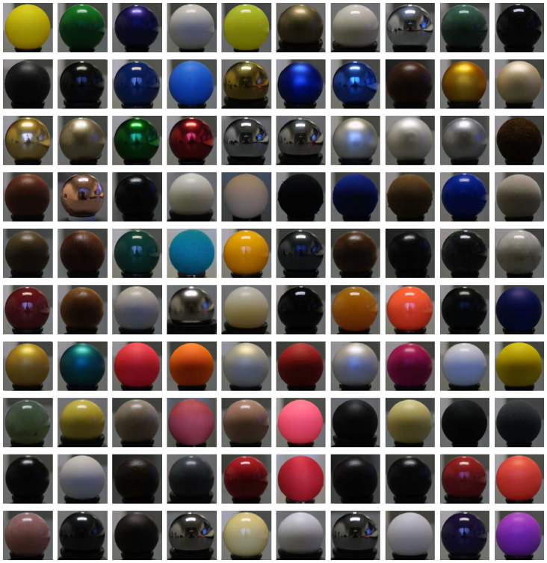
Grand Challenges in BSDF Measurement
The MERL MIT BRDF database.
Measured by Matusik et al. [2003].
Includes BRDF measurements of 100 different isotropic materials.
Do not include any BTDF measurements.
Notes:
One of the most popular BRDF database is the MERL MIT database. BRDFs in the MERL MIT database have been acquired by Matusik et al. [2003]. The MERL MIT database consists of 100 different isotropic BRDF measurements which include highly dense and regular samples. Therefore, this database has been used by many researchers for validation, experimental analysis and comparison purposes. This data set is also suitable for direct rendering. However, Matusik et al. [2003] do not address the light transmission to describe BTDFs which are required to render translucent surfaces.

Slide 5
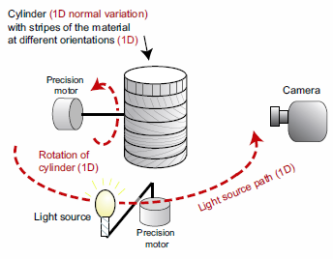
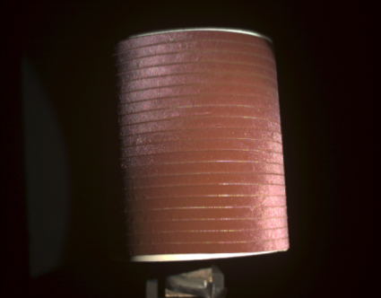
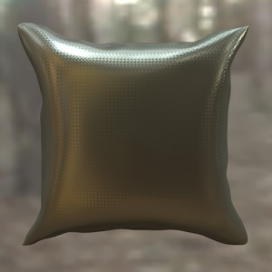
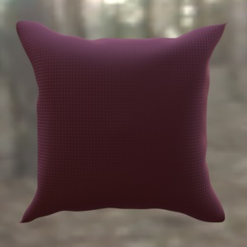
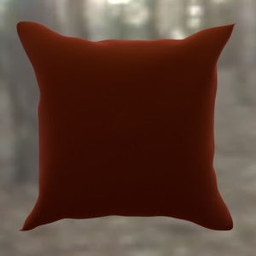
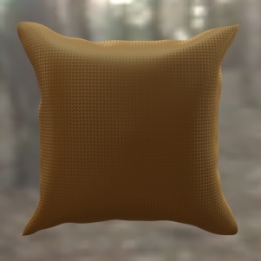
Grand Challenges in BSDF Measurement
A small BRDF database.
Measured by Ngan et al. [2005].
Includes BRDF measurements of 4 different anisotropic materials.
Measurements are sparse, irregular and noisy.
Do not include any BTDF measurements.
Notes:
Furthermore, Ngan et al. [2005] measured 4 different anisotropic BRDFs. Since anisotropic BRDF domain is four dimensional (4D) and it’s very time consuming to measure whole 4D domain, this data set includes noisy, irregular and sparse measurements. Therefore, Ngan et al.’s anisotropic BRDF data set is not suitable for data-driven based representations and it’s not suitable for direct rendering. This data set must be preprocessed before it can be represented by a suitable BRDF model. In addition, Ngan et al. [2005] do not address the light transmission to describe BTDFs which are required to render translucent surfaces.

Slide 6
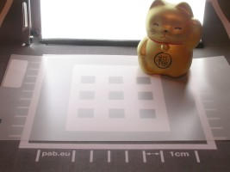
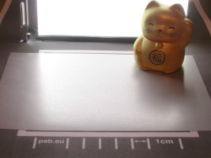
Grand Challenges in BSDF Measurement
The BME database.
Measured by Apian-Bennewitz [2014].
Includes both BRDF and BSDF measurements.
Measurements are sparse, irregular and noisy.
Normal incidence and grazing angles measurements can not be done with pgII goniophotometer.
Notes:
On the other hand, BME database includes BRDF, BTDF and BSDF measurements. Materials in BME database have been measured by Apian-Bennewitz [2014]. Although, this database includes both reflection and transmission measurements, it has several drawbacks. Firstly, measurements in BME database are noisy, irregular and sparse. Secondly, number of materials in BME database is not enough for a strong validation and comparison. Thirdly, measurements at some important incident angles, such as normal incidence and grazing angles, can not be done by pgII goniophotometer. Because of these drawbacks, measurements from BME database must be preprocessed before representing and rendering measured translucent materials.

Slide 7
Grand Challenges in BSDF Modeling
Noisy, irregular and sparse reflectance and transmittance measurements can be represented by analytical BRDF, BTDF or BSDF models.
Ngan et al. [2005] have experimentally validated that BRDF models, which include Fresnel term [Schlick 1994], can represent the measurements at grazing angles and normal incidence more accurately than its competitors.
Although, analytical BRDF models can represent a large number of materials, they can not represent all materials quite well [Ngan et al. 2005; Bagher et al. 2012].
Notes:
Noisy, irregular and sparse reflectance and transmittance measurements can be represented by analytical BRDF, BTDF or BSDF models. Ngan et al. [2005] have experimentally validated that BRDF models, which include Fresnel term [Schlick 1994], can represent the measurements at grazing angles and normal incidence more accurately than its competitors. Although, analytical BRDF models can represent a large number of materials, they can not represent all materials quite well [Ngan et al. 2005; Bagher et al. 2012].

Slide 8
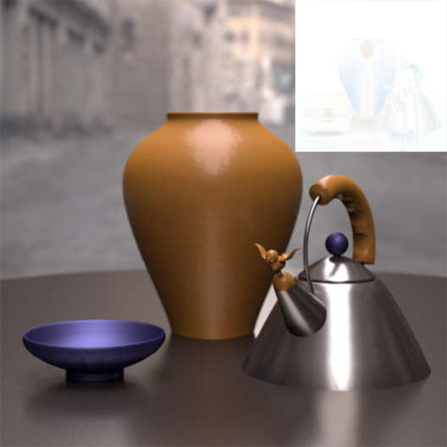
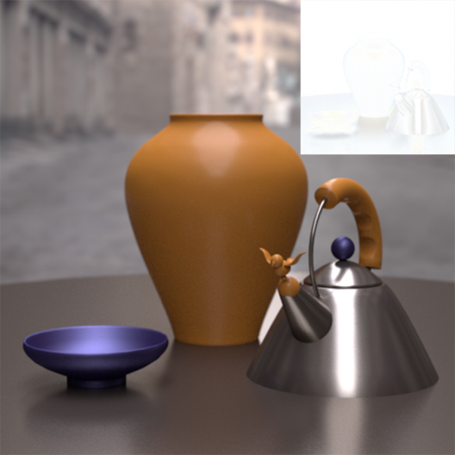
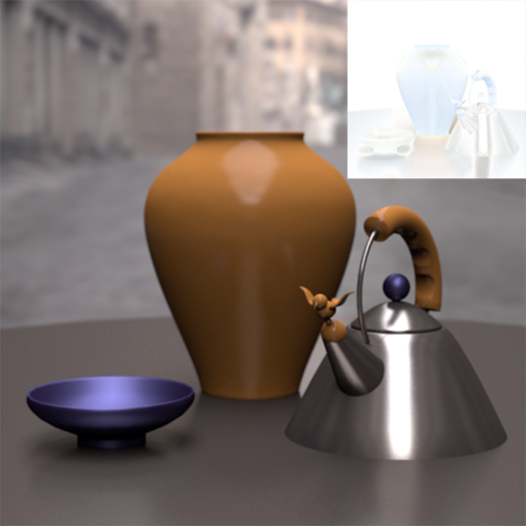
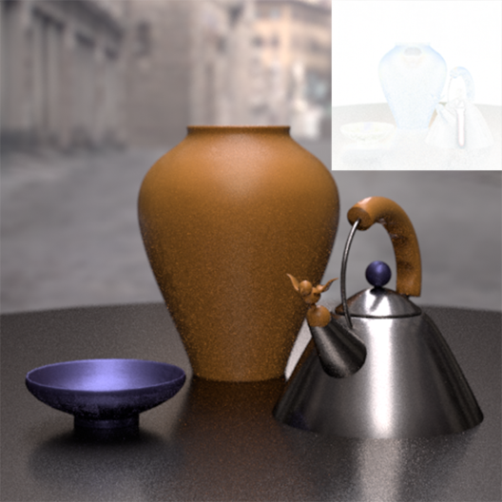
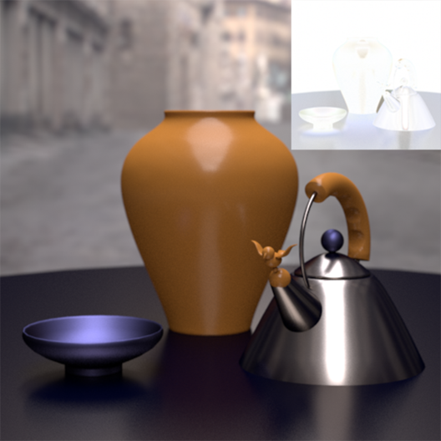
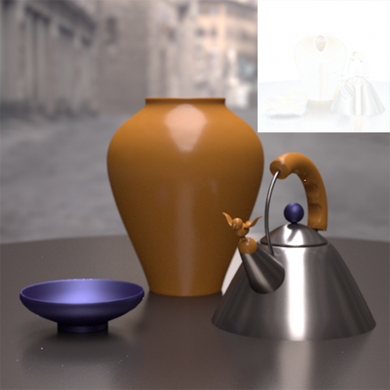
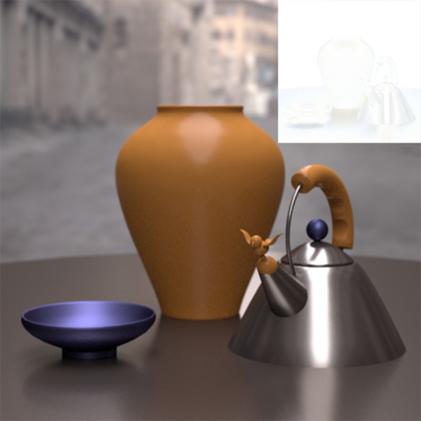
Grand Challenges in BSDF Modeling
Reference image
(b) Ashikhmin-Shirley
(PSNR = 31.8419)
(c) Cook-Torrance
(PSNR = 31.1835)
(d) Edwards
(PSNR = 26.4502)
(e) Lawrence
(PSNR = 30.3722)
(f) Ward
(PSNR = 22.2599)
(g) Ward-Duer
(PSNR = 31.7116)
(h) Kurt et al.
(PSNR = 32.1210)
Notes:
Here, you can see a visual comparisons of various well-known BRDF representations on the Princeton scene. In this comparison, the Peak Signal-to-Noise Ratio (PSNR) values [Richardson 2002] and difference images are also reported to see differences between the BRDF representations. For example, Ashikhmin-Shirley [2000], Cook-Torrance [1981] and Kurt et al. [2010] BRDF models include Fresnel terms. Therefore, these BRDF models generally give better fitting results than Ward [1992] and Ward-Duer [2005] BRDF models which do not include any Fresnel terms.

Slide 9
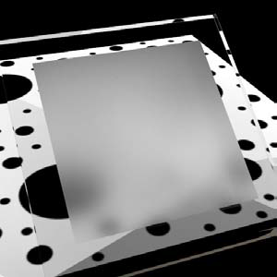
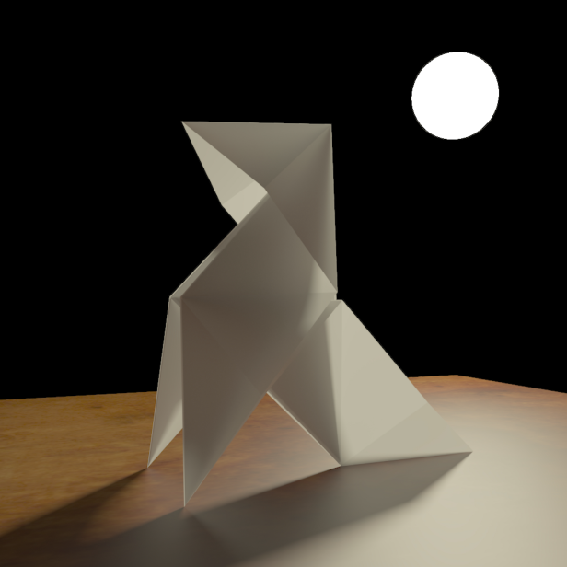
Grand Challenges in BSDF Modeling
Walter et al.’s [2007] BSDF model.
It’s based on microfacet theory.
It’s for representing rough glass material.
It uses GGX microfacet normal distribution.
Papas et al.’s [2014] BSDF model.
It’s a physically-based BSDF model.
It’s for representing paper material.
It includes absorption and scattering parameters.
These BSDF models are not suitable for representing custom-designed translucent materials.
Walter et al. [2007]
A Microfacet-Based BSDF Model
Papas et al. [2014]
A Physically-Based BSDF Model
Notes:
Walter et al.’s [2007] analytical BSDF model is based on microfacet theory and it’s for representing rough glass material. In their work, Walter et al. introduced GGX microfacet normal distribution which works extremely well when representing rough translucent materials [Papas et al. 2014]. Recently, Papas et al. [2014] introduced an analytical BSDF model for representing paper material. Papas et al.’s physically-based BSDF representation includes absorption and scattering parameters and accounts for single scattering, multiple scattering and surface reflection. However, none of these BSDF models are suitable for representing custom-designed translucent materials that have unusual scattering properties and/or highly anisotropic structures, such as in daylight redirecting films.

Slide 10
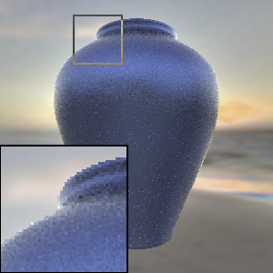
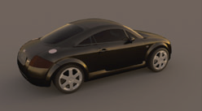
Grand Challenges in BSDF Modeling
Lawrence et al.’s [2004] BRDF model.
It’s a data-driven BRDF representation.
It’s based on NMF algorithm.
It’s sutiable for efficient importance sampling.
Öztürk et al.’s [2010] BRDF model.
It uses Rusinkiewicz [1998] coordinate system.
It’s based on Copula distributions.
Lawrence et al. [2004]
A Factored BRDF Model
Öztürk et al. [2010]
A Copula-Based BRDF Model
Notes:
Lawrence et al.’s [2004] data-driven BRDF representation uses a Non-negative Matrix Factorization (NMF)-based algorithm and it’s also suitable for efficient BRDF importance sampling. Öztürk et al.’s [2010] BRDF model is based on Rusinkiewicz coordinate system [Rusinkiewicz 1998] and uses Copula distributions for representing measured reflectance data.

Slide 11
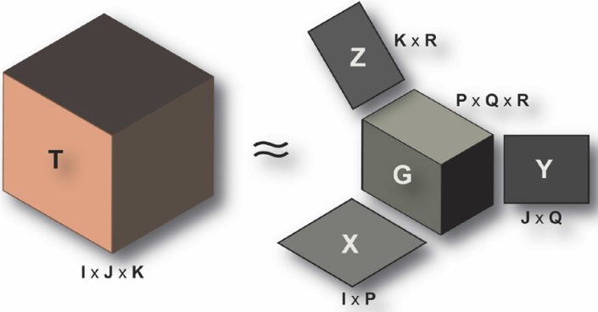
Grand Challenges in BSDF Modeling
Bilgili et al.’s [2011] BRDF model.
It’s a data-driven BRDF representation.
It’s based on Tucker factorization.
It’s suitable for efficient importance sampling.
Pacanowski et al.’s [2012] BRDF model.
It’s based on Rational Functions.
It uses Rusinkiewicz [1998] coordinate system.
None of these data-driven BRDF representations can represent noisy, sparse and irregular measurements.
Bilgili et al. [2011]
A Factored BRDF Model
Pacanowski et al. [2012]
A Rational BRDF Model
Notes:
Bilgili et al.’s [2011] factored BRDF representation uses a Tucker-based factorization algorithm to compactly represent measured BRDF data and it allows to efficient BRDF importance sampling. Pacanowski et al. [2012] uses rational functions to compactly represent measured reflectance data. Pacanowski et al.’s [2012] data-driven BRDF representation is based on Rusinkiewicz coordinate system [1998] as this coordinate system helps to represent specular highlights more accurately. However, none of these data-driven BRDF representations can represent noisy, sparse and irregular measurements. Therefore, noisy, sparse and irregular measurements need to be preprocessed before they can be represented with a data-driven based representation.

Slide 12
Key Issues
One of the key issues is creating a general framework for sharing and rendering measured BSDFs.
Ward et al. [2012] proposed an XML representation and an Open Source C library to support BSDFs in rendering applications.
It allows for the efficient representation, query and Monte Carlo sampling of real-world BSDFs in a model-free framework.
It includes two data-driven BSDF representation.
Matrix-based BSDF representation.
Tensor tree BSDF representation.
It helps to handle advanced schemes such as Complex Fenestration Systems (CFSs).
Notes:
One of the key issues is creating a general framework for sharing and rendering measured BSDFs. Accordingly, Ward et al. [2012] proposed an XML representation and an Open Source C library to support BSDFs in rendering applications. The proposed library allows for the efficient representation, query and Monte Carlo sampling of real-world BSDFs in a model-free framework. The proposed library includes two data-driven based BSDF representations: Matrix-based BSDF representation and Tensor tree BSDF representation. Furthermore, Ward et al.’s [2012] proposed library helps to handle advanced schemes such as Complex Fenestration Systems (CFSs) .

Slide 13
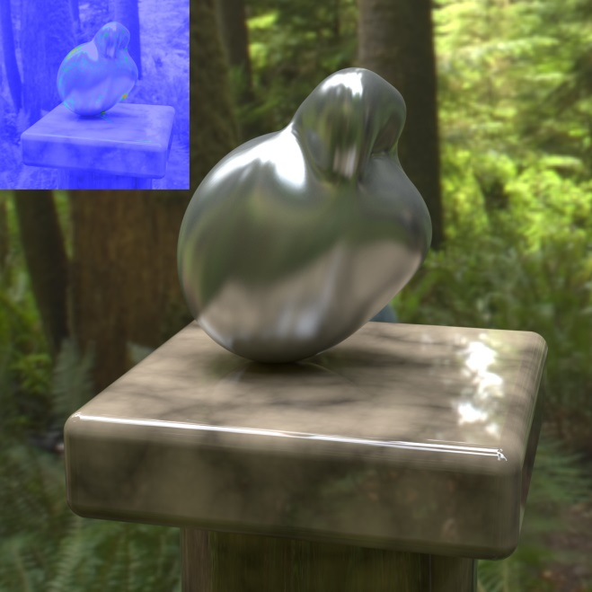
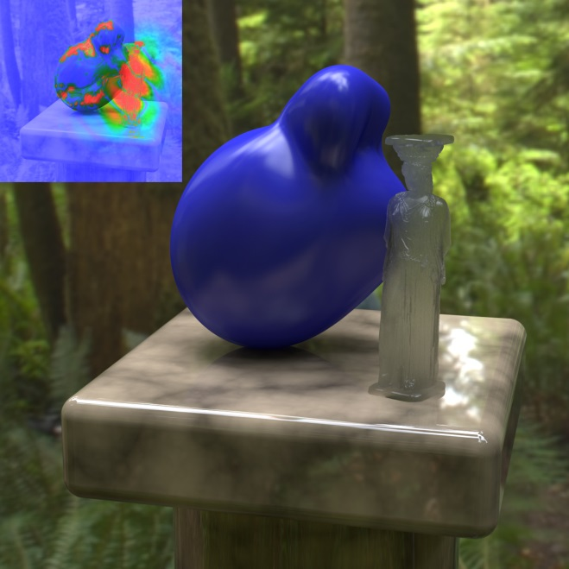
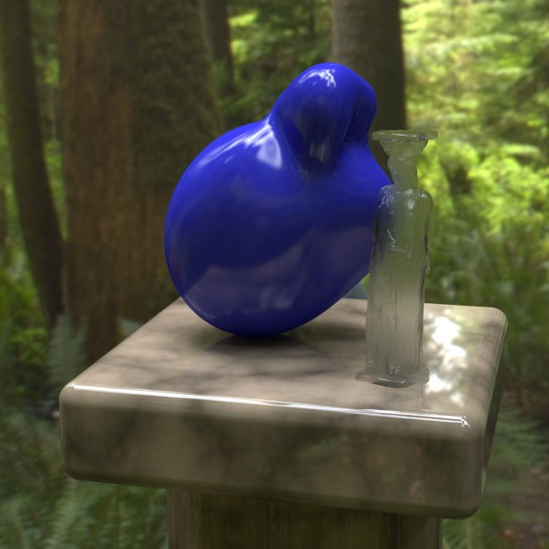
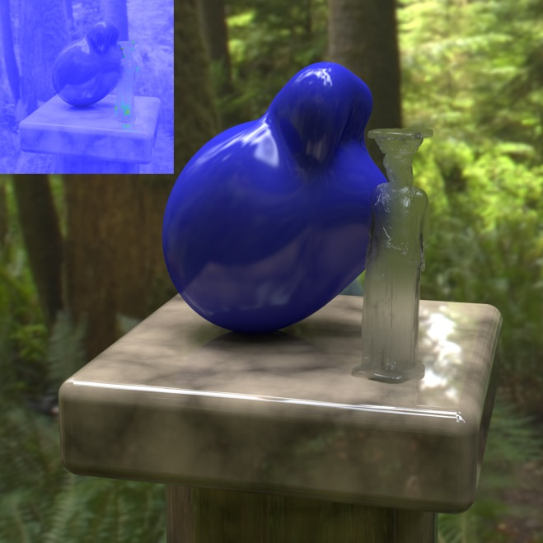
Key Issues
Matrix-based BSDF representation
Reference image
Tensor tree BSDF representation
Notes:
The Matrix-based BSDF representation uses a fixed number of incident and exiting directions to form a rectangular matrix of values. The number of incident and exiting directions are often equal, since square matrices can be more easily composed into a single matrix that includes the effects of interreflections between layers. Matrix-based BSDF representation has advantages for certain matrix operations. On the other hand, Tensor tree BSDF representation has an adaptive density which helps to represent highly peaked data more accurately. In other words, a tensor tree BSDF model represents the sharp peaks in a BSDF by subdividing adaptively in different regions of the distribution. Sample density is coordinated between input and output directions, since higher density required in one implies that higher density is required in the other. As you can see in this comparison, Tensor tree BSDF representation provides a more accurate representation of measured BSDF data than Matrix-based BSDF representation. For Matrix-based BSDF representation, increasing the matrix resolution would help to the accuracy of the representation, but a uniform partition of the hemisphere at the resolution required to capture such peaks would take gigabytes of storage and be very inefficient. This is where we may prefer a more adaptive solution that is Tensor tree BSDF representation.

Slide 14
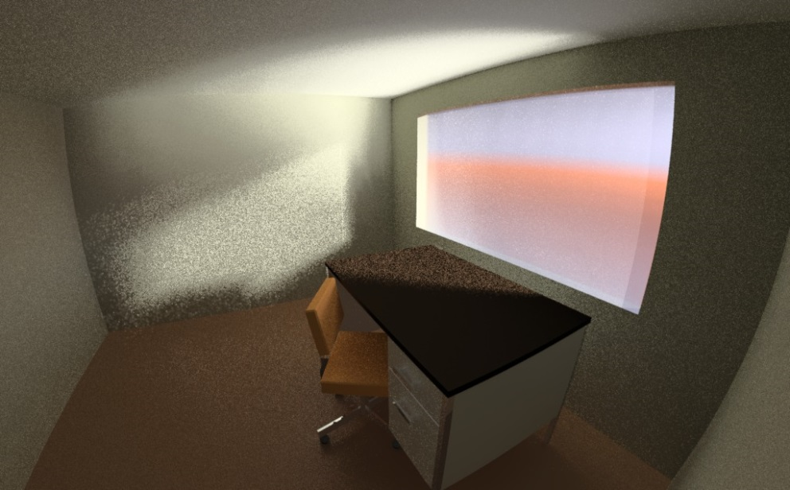
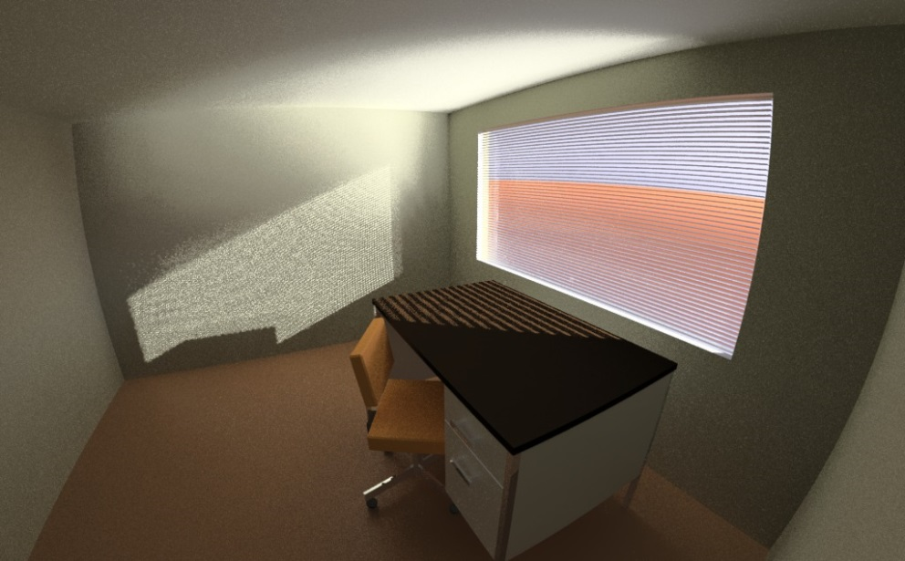
Key Issues
Matrix-based BSDF representation
Tensor tree BSDF representation
Tensor tree BSDF representation as a proxy for detailed geometry
Notes:
Complex Fenestration Systems (CFSs) have been designed to convey daylight in specialized ways, such as prismatic glazings, holographic films, daylight redirecting films and specular louvers. One of the most challenging aspects of a Complex Fenestration System (CFS) is rendering its appearance. Simulating Complex Fenestration Systems (CFSs) correctly is especially important to modern building designers. While aggregate behavior as described by a BSDF is a useful way to model illumination, spatial variations determine what a window looks like to an occupant, and may impart a pattern to a solar beam component as well. As you can see in these renderings, Complex Fenestration Systems (CFSs) can be simulated more correctly when the data-driven BSDF representation is used as a proxy for detailed geometry. In this setting, the geometry is used for direct views and shadow testing and the data-driven BSDF representation is used for characterizing light reflected and transmitted by the Complex Fenestration System (CFS) . The proxy approach proves an acceptable compromise for rendering, as shown in the last rendering. Indirect contributions are smoothly integrated because sample rays do not see the intensity variations of the blinds themselves, relying on the measured BSDF data that is spatially averaged. Achieving a similar level of quality without the benefit of a data-driven BSDF takes 5 times as long.

Slide 15
Key Issues
Another key issue is filling noisy, sparse and irregular measurements as many data-driven based BSDF representations require noise-free, continuous and regular BSDF measurements.
Ward et al. [2014] proposed an interpolation technique for filling a sparse set of incident angle BSDF measurements.
It is based on a Lagrangian mass-transport solution [Bonneel et al. 2011].
It fits a set of radial basis functions to each measured distribution, which allows to interpolate between sparse incident directions.
The proposed interpolation technique is especially suited for anisotropic BSDFs.
Notes:
Another key issue is filling noisy, sparse and irregular measurements, as many data-driven based BSDF representations, such as Matrix-based BSDF representation and Tensor tree BSDF representation [Ward et al. 2012], require noise-free, continuous and regular BSDF measurements. Recently, Ward et al. [2014] proposed an interpolation technique for filling a sparse set of incident angle BSDF measurements. The proposed interpolation technique is based on a Lagrangian mass-transport solution [Bonneel et al. 2011] and it fits a set of radial basis functions to each measured distribution, which allows to interpolate between sparse incident directions. The proposed interpolation technique is especially suited for anisotropic BSDFs, because anisotropic BSDF measurements generally include many holes and noise.

Slide 16
Key Issues
Linear interpolation
Ward et al.’s [2014] Lagrangian mass transport based interpolation
Notes:
First of all, Ward et al. [2014] fits a set of radial basis functions to each measured distribution, which allows to interpolate between sparse incident directions. Next, they organize incident measurement directions in a triangle mesh for efficient lookup and interpolation. They use an incremental Delaunay construction equivalent to gift-wrapping on the sphere [VL11], which progressively adds vertices without requiring edge flipping or removal. This allows for transport plans to be computed as triangles are formed. Then, they extend Bonneel et al.’s Lagrangian mass transport based interpolation technique to work on the computed triangle mesh of incident directions. This allows for specular peaks to be shifted rather than blended during interpolation. As you can see in this comparison, Ward et al.’s [2014] Lagrangian mass-transport based interpolation technique is better than a naive linear interpolation. For efficient rendering and simulation, interpolated data can be converted to a standard BSDF representation, such as Tensor tree BSDF representation, and it can be used in a model free framework [Ward et al. 2012].

Slide 17
Conclusions
A summary of grand challenges and key issues in BSDF measurement and representation.
There is a need for a huge database that includes variety of BSDF measurements.
There is a need for an accurate interpolation technique and an efficient BSDF representation.
Extrapolating BSDF data at grazing angles and modeling backlit appearance are other big challenges and they should be carefully handled.
Notes:
In this presentation, we summarized grand challenges and key issues in BSDF measurement and representation. We hope that this short outline of the key issues encourages researchers to focus on these issues. We also hope that this short outline of the key issues helps to advance BSDF measurement and representation.
Indeed, there is a need for a huge database that includes variety of BSDF measurements. We think that both researchers and designers will use such a database for comparison, validation and simulation purposes. In the future, we’re planing to help this process by measuring various translucent materials and providing them with a suitable BSDF library. In BSDF representation side, there is a need for an accurate interpolation technique and an efficient BSDF representation. Extrapolating BSDF data at grazing angles and modeling backlit appearance are other big challenges and they should be carefully handled. In the future, we’re also planing to investigate an accurate BSDF representation that handles these challenges quite well.
I hope you enjoyed this presentation, and thank you for you attention.

Slide 18
Thank You...
Thank You
Notes:
I hope you enjoyed this presentation, and thank you for your attention.

