Slide 1
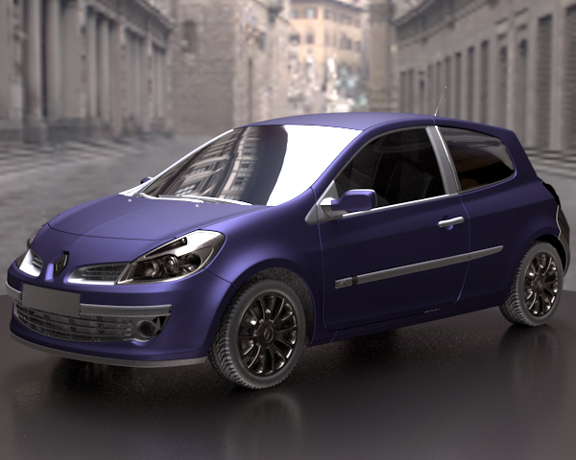
Modeling BRDF by a Probability Distribution
GraphiCon’2010
20th International Conference on Computer Graphics and Vision September 20-24, 2010, St.Petersburg, Russia
Aydın ÖZTÜRK
Murat KURT
Ahmet BİLGİLİ

Slide 2
Bidirectional Reflectance Distribution Function (BRDF)
BRDF functions defines the surface reflection behaviour through a mathematical model.
BRDF is first formulated by Nicadamus using the following relationship:
Incoming, outgoing and surface normal vectors,
Differential outgoing radiance,
Differential irradiance,
Incoming radiance,
Differential solid angle.

Slide 3
Physical Properties of BRDF
A good BRDF should obey the following principles:
Reciprocity
Energy Conservation

Slide 4
Modeling BRDF by Probability Distributions
Ward (1992) BRDF model,
Gaussian Distribution.
Edwards et al. (2006) BRDF model,
Halfway Vector Disk distribution.
Öztürk et al. (2010) Copula-Based BRDF model,
Archimedean Copula distributions.

Slide 5
Copula Distributions
Copula is a multivariate cumulative distribution function of the uniform random variables on the interval [0,1].
They provide a simple and general structure for modeling multivariate distributions through univariate marginal distributions.

Slide 6
Copula Distributions (2)
Random Variables
Cumulative Distribution
Marginal Cumulative Distributions
Copula Distribution

Slide 7
Copula Distributions (3)
Probability Density Function (pdf)
Marginal Density function
Copula pdf

Slide 8
Archimedean Copula Distributions
Generator Function
Inverse of Generator Function
Properties of Generator Functions
Archimedean Copula Distribution

Slide 9
Archimedean Copula Distributions (2)
Frank Generator Function
Copula Probability Distribution Function

Slide 10
Copula-Based BRDF Model
Scaling coefficient:
Marginal Cumulative Distributions:

Slide 11
Copula-Based BRDF Model (2)
Scaled BRDF values
Measured BRDF values
Sum of measured BRDF values
Marginal Density function
Marginal Cumulative Distribution

Slide 12
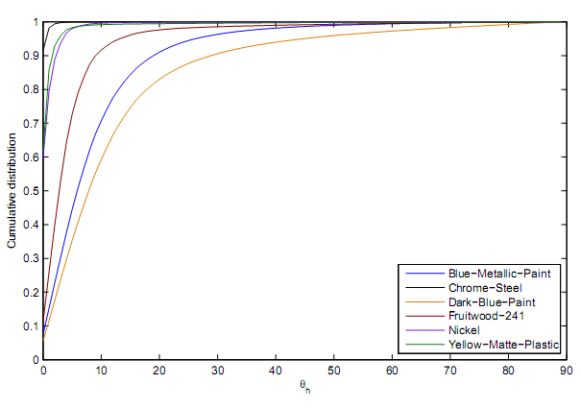
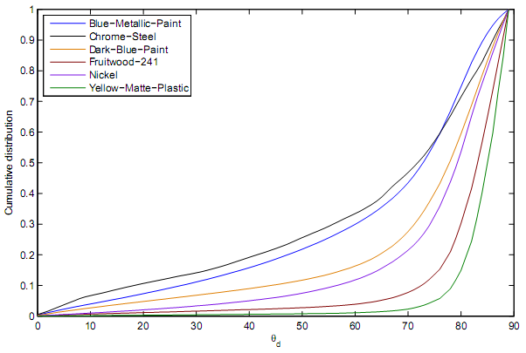
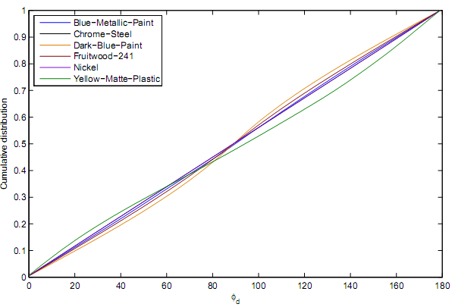
Copula-Based BRDF Model (3)
Empirical cumulative marginal distributions of measured BRDF

Slide 13
Copula-Based BRDF Model (3)
We have observed that the marginal distributions of for specular materials are extremely skewed. Our empirical results showed that copula distributions do not provide satisfactory approximations for these cases.
We overcome this difﬁculty by dividing data along into subsamples and ﬁtting the BRDF model to each of these subsamples.
We defined 6 subsamples by dividing into 6 non-overlapping intervals each with a length of 90º/6 = 15º.

Slide 14
Physical Properties of Copula-Based BRDF model
Reciprocity
Copula-Based BRDF Model satisfies reciprocity if we use the identity

Slide 15
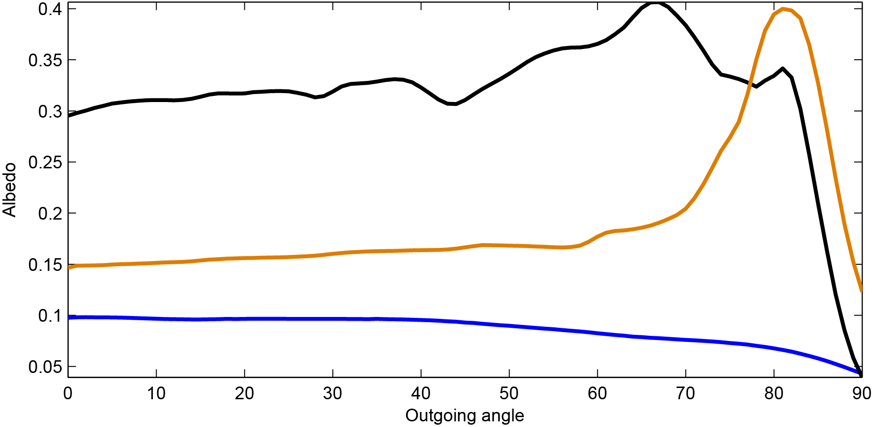
Physical Properties of Copula-Based BRDF model (2)
Energy Conservation
Our BRDF model depends on a multivariate probability distribution function but it is scaled by a different coefﬁcient K for each subsumple. In this sense, our model may not be considered as an energy conserving model.
However, for all samples considered in this study, our BRDF model empirically satisfies the energy conservation property.
Albedo for 3
isotropic materials.
Nickel,
Yellow-Matte-Plastic,
Blue-Metallic-Paint.

Slide 16
Importance Sampling
Importance sampling is a variance reduction technique in Monte Carlo rendering
Rendering Equation
Monte Carlo Estimator of Rendering Equation

Slide 17
Importance Sampling
If BRDF model is a probability distribution, it can be simplified to:
Important for real time rendering if is provided.

Slide 18
Importance Sampling
If BRDF can be modeled by a 4 dimensional Archimedean Copula distribution, incoming light vectors can be sampled from

Slide 19
Results
Various spheres were rendered with our Frank copula model using different materials. Columns left to right: alum-bronze, black-oxidized-steel, dark-specular-fabric, green-metallic-paint, pvc and silver-metallic-paint. Rows top to bottom: Reference images were rendered using measured data; images were rendered using our Frank copula model and color-coded difference images (Color-coded differences are scaled by a factor of ﬁve to improve the visibility of differences between the real and approximated images).

Slide 20
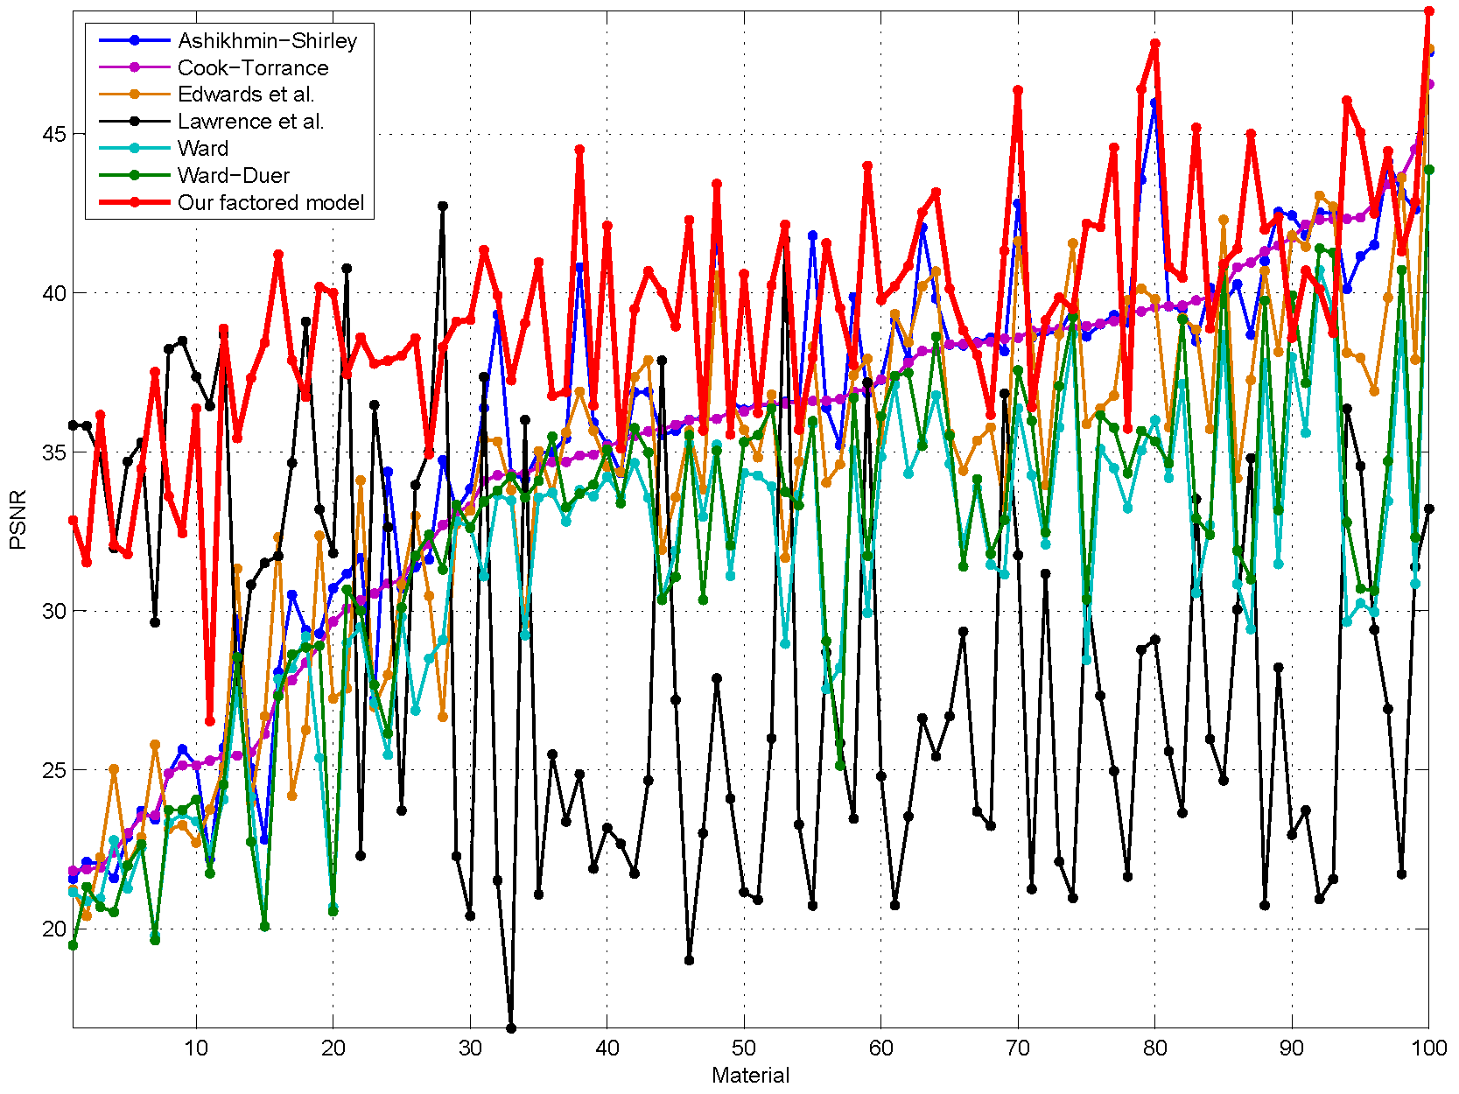
Results
The PSNR values of the Ashikhmin-Shirley, the Cook-Torrance, the Ward and our Frank copula models. The BRDFs are sorted in the PSNRs of the Ashikhmin-Shirley model (Blue) for visualization purpose.
Image is taken from following paper:
Öztürk, A., Kurt, M., Bilgili, A., A Copula-Based BRDF Model, Computer Graphics Forum, 29(6), 1795-1806, 2010.

Slide 21
GraphiCon’2010
20th International Conference on Computer Graphics and Vision September 20-24, 2010, St.Petersburg, Russia
Thank you !
Questions ?

